Slide 1
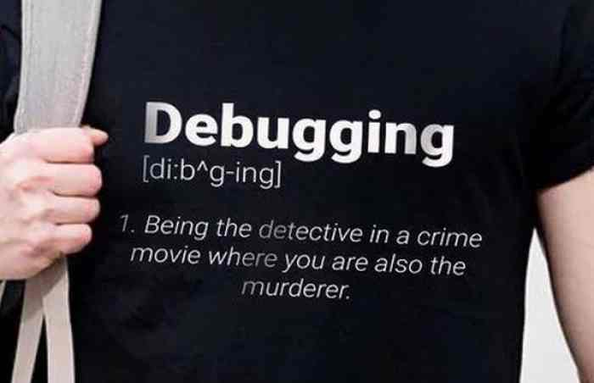

Debugging
Server Side Development / Web Programming
Bug arrr where?
Dam bugs

Slide 2

What is debugging?
Server Side Development / Web Programming
Fun Fact
The terms "bug" and "debugging" are popularly attributed to Admiral Grace Hopper in the 1940s. While she was working on a Mark II computer at Harvard University, her associates discovered a moth stuck in a relay and thereby impeding operation, whereupon she remarked that they were "debugging" the system.

Slide 3

Syntax Errors
Server Side Development / Web Programming
Syntax error are the most common bugs. These are the bug you will write the most when you first start to program.
A syntax error means the way you have written your code is incorrect
The most common syntax errors are:
extra or missing braces {}
missing , . ; : [
Typos & Spelling mistakes
Syntax errors are picked up by the compiler and need to be corrected before the code can be run.

Slide 4
Run time errors
Server Side Development / Web Programming
A runtime error is an error that occurs well your code is running.
Run time errors are commonly caused by flaws in your codes logic. These errors are normally error you have not anticipated well writing your code. e.g. you have create code that knows what to do with data that is returned from a API call but your code dose not know what to do if the API call fails
Anther common cause of runtime error are typos and spelling mistakes. These often cause NULL error or object undefined errors

Slide 5
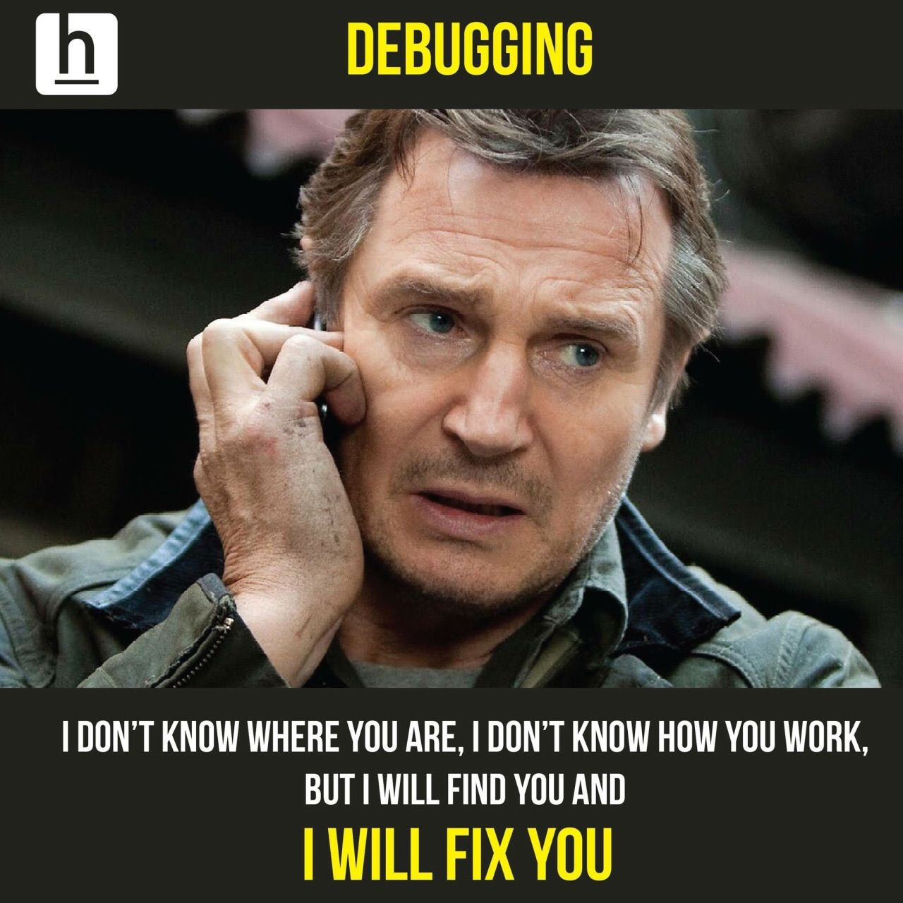
An emotional roller coaster
Server Side Development / Web Programming
The entertainment industry display coding and development in a totally different light to reality.
As a programmer a large amount of time spent on solving bugs.
Also programmers don’t like to admit they write code with bugs.
So if you feel like you can’t code because you are fixing bugs all the time. Just remind yourself that is part of the job.

Slide 6
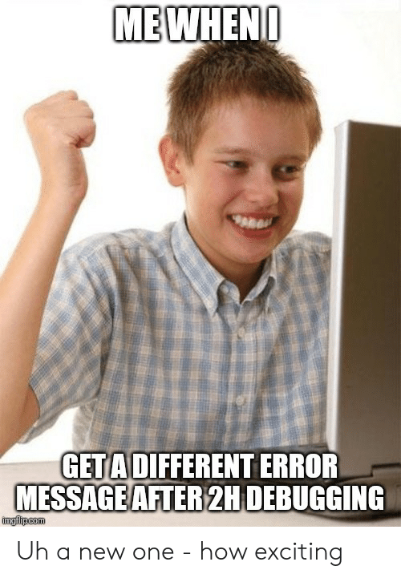

Slide 7
Demo
Syntax Errors

Slide 8

Debugging
Tools
Server Side Development / Web Programming
We have tools?
Yes it comes in a can

Slide 9
Debugging Tool 1 - The Console
Server Side Development / Web Programming
The Console
console.log()
console.error()
console.warning()
The console is one of the quickest and easiest ways to find errors
It’s easy its quick
It can also help you better understand the flow of your application particularly when you are starting out

Slide 10
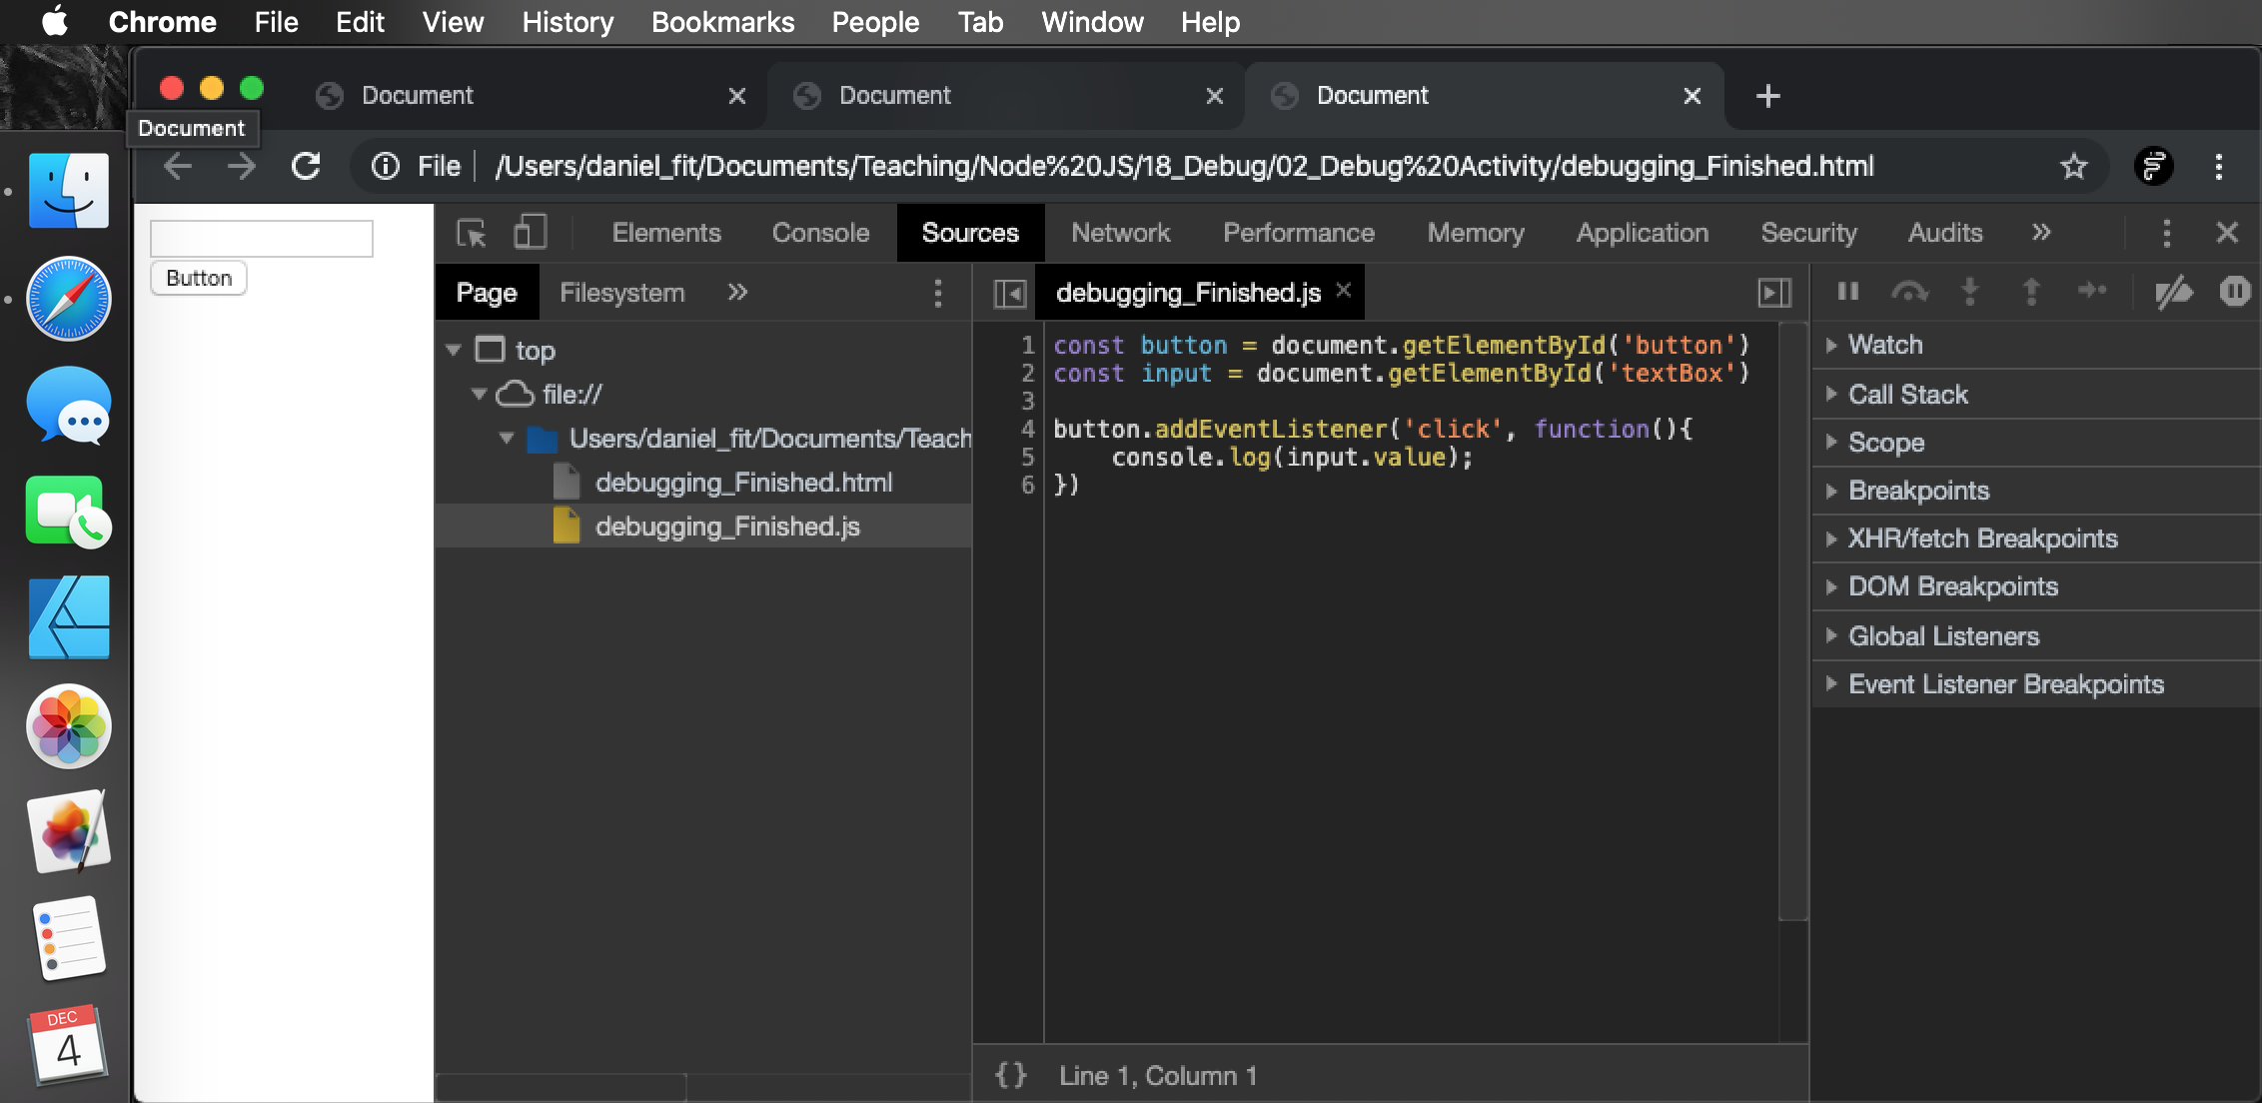
Debugging Tool 2 - Developer Tools
Server Side Development / Web Programming
Developer Tools> Sources Tab

Slide 11
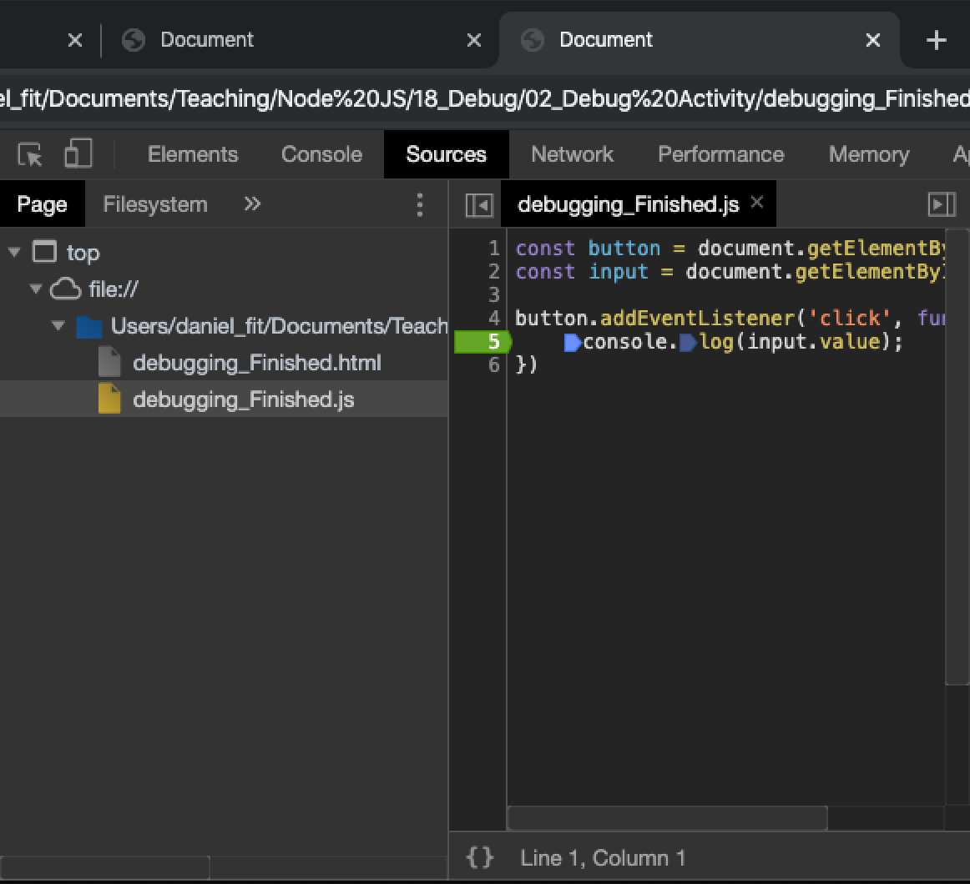
Debugging Tool 2 - Developer Tools
Server Side Development / Web Programming
Breakpoint
A break point pauses the application at that point/line
You can then hover over variables and values in your code to see what they are holding at runtime
You can even run commands in the console well your application is paused
Breakpoint

Slide 12
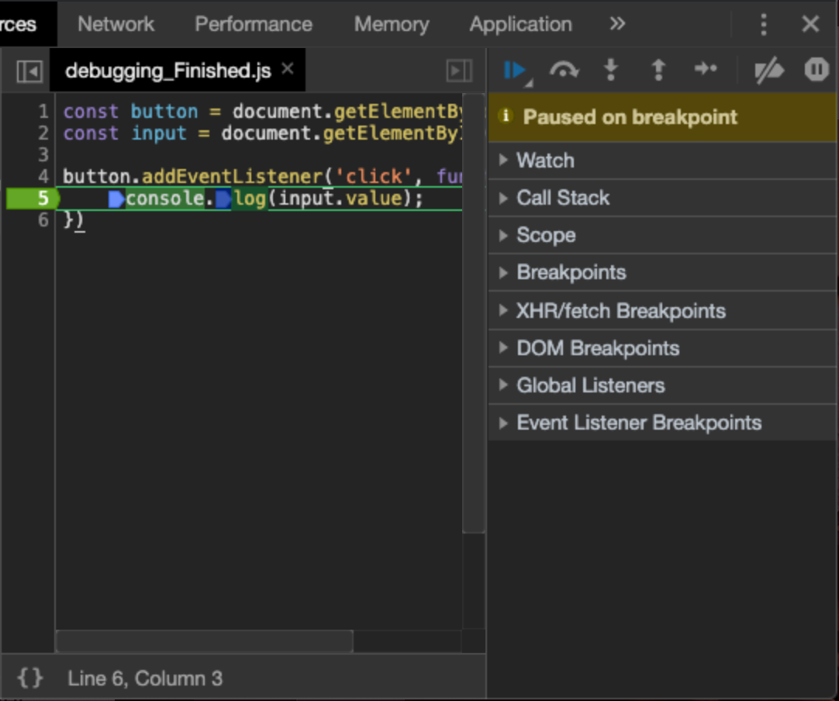
Debugging Tool 2 - Developer Tools
Server Side Development / Web Programming
Resume
Resume will run the application again
Resume

Slide 13
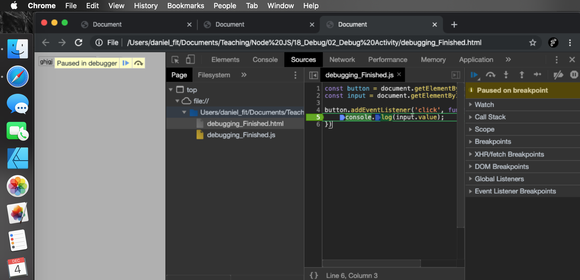
Debugging Tool 2 - Developer Tools
Server Side Development / Web Programming
Allows us to step over a function
Allow us to step into a function and watch the code run in the function
Allows us to step out of a function
Step next line
These are more advanced tools and are not required to solve simple problems
But if you have a hard time solving a problem and the console is not cutting it the next step is BREAKPOINTS!

Slide 14
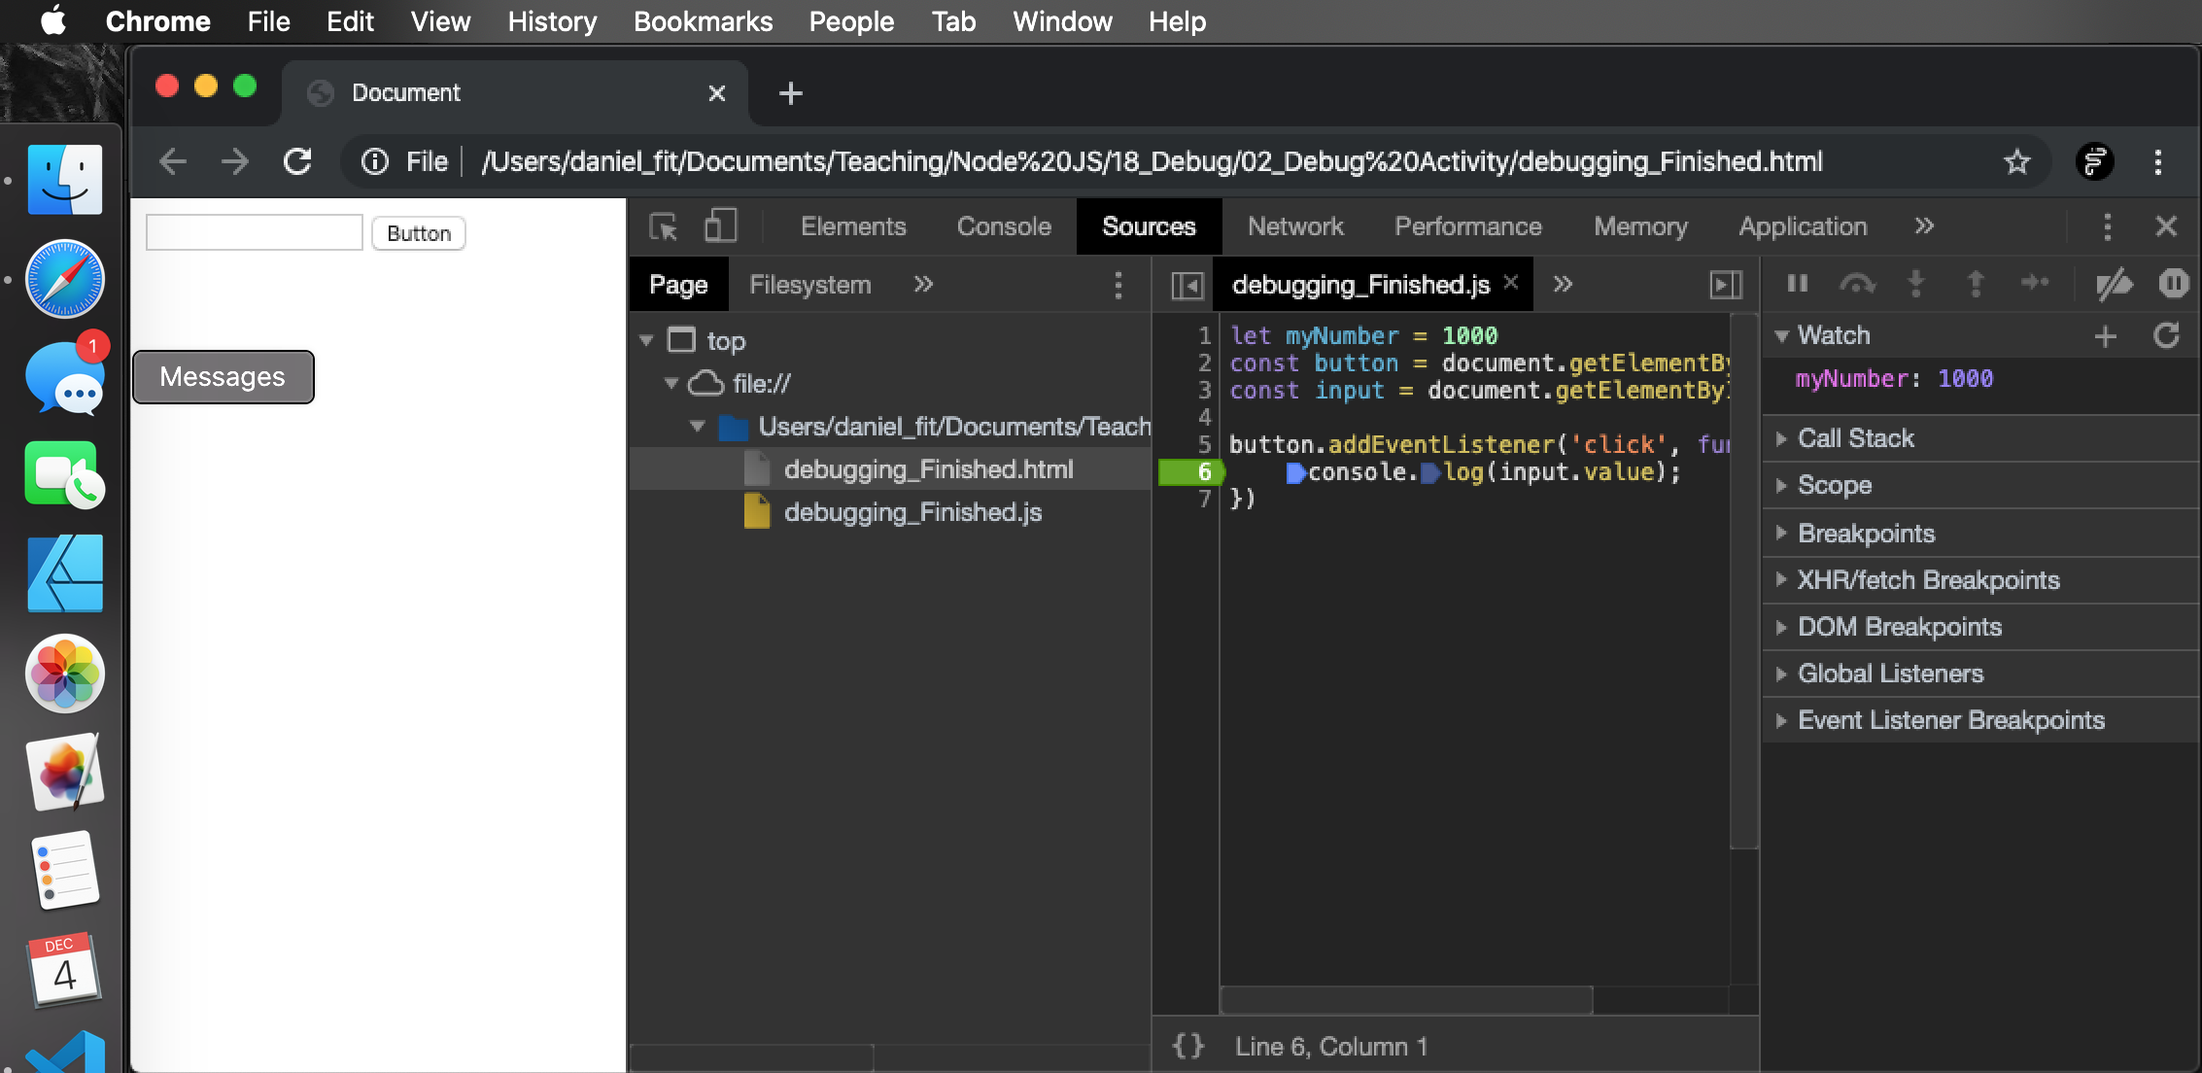
Debugging Tool 2 - Watch
Server Side Development / Web Programming
Watch allows you to list variables you want to watch/keep track of.
As you step though the code you can see the watched values change

Slide 15
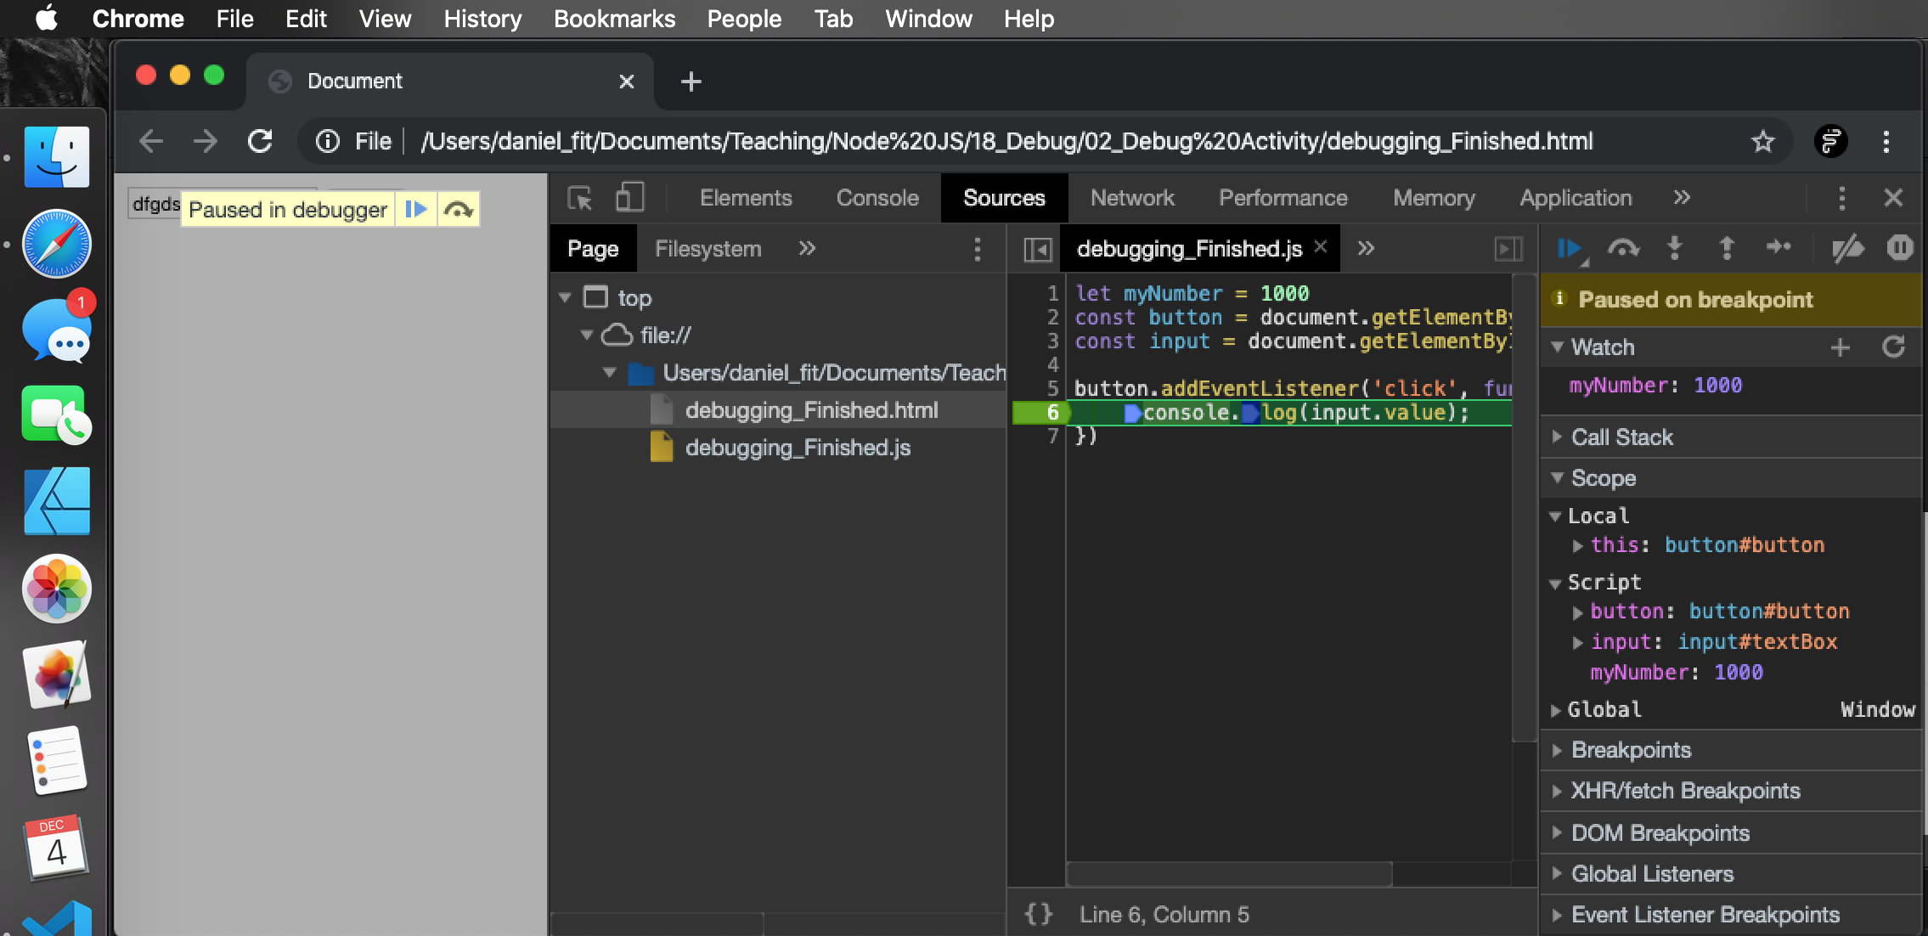
Debugging Tool 2 - Watch
Server Side Development / Web Programming
Scope will tell you what is in scope for a particular breakpoint/line
You may use this to check if a line has access to variable. (Check the variable is in scope)

Slide 16
Debugging Tool 2 - Watch
Server Side Development / Web Programming
Scope will tell you what is in scope for a particular breakpoint/line
You may use this to check if a line has access to variable. (Check the variable is in scope)

Slide 17
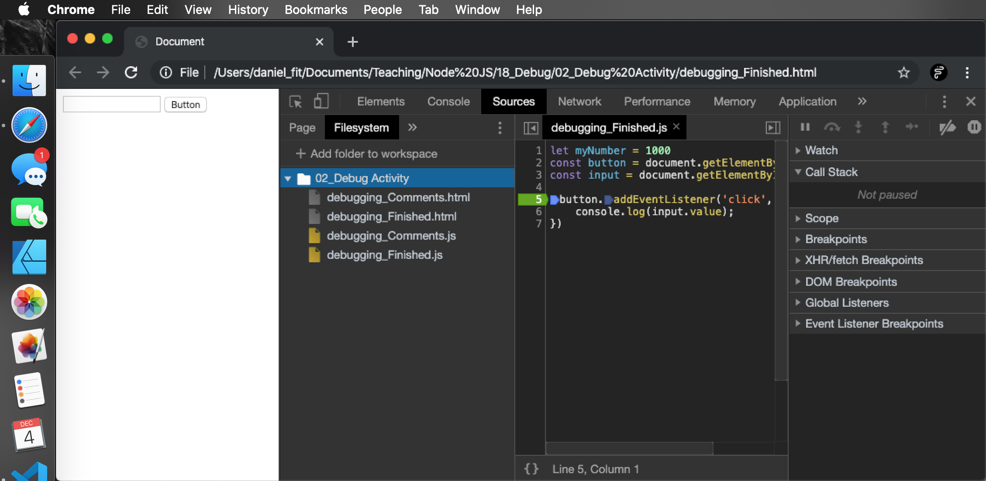
Debugging Tool 2 - Filesytem
We can actually edit our code in the spruce tab of the dev tools but it will not save the changes
However we can save the changes if we tell Chrome were our files are located
If you add a folder workspace to the FileSystem tab it will allow you to save edits.

Slide 18
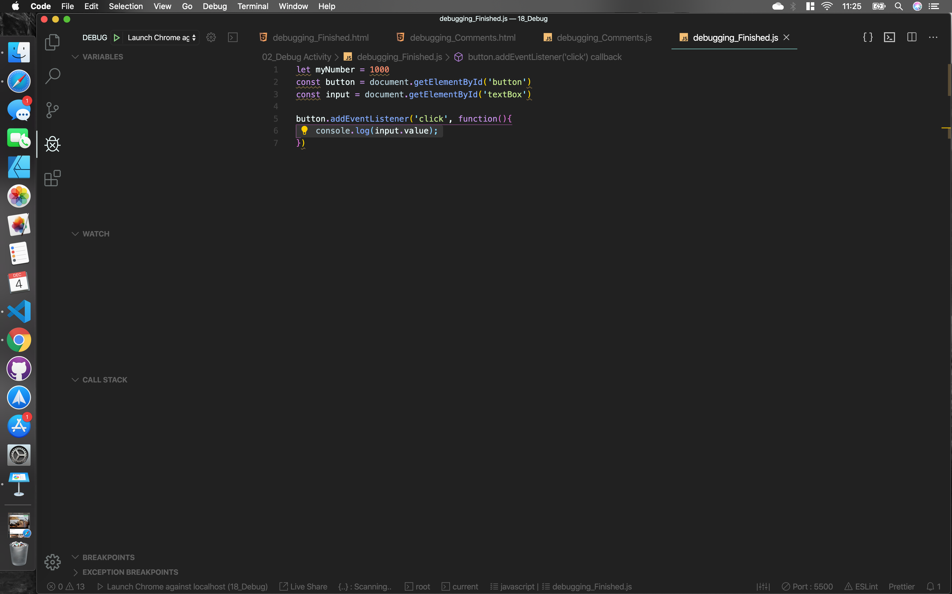
Debugging Tool 2 - VS Code Debugging
If you open the debug tab with he extension installed you will find similar rollouts to what we have in the dev tools. Variables, Watch, Call Stack, Breakpoints .ect

Slide 19
Debugging Tool 2 - VS Code Debugging
If you open the debug tab with he extension installed you will find similar rollouts to what we have in the dev tools. Variables, Watch, Call Stack, Breakpoints .ect
When you click run you will be prompted to select if you are using client side JavaScript or Node.js. Then you will need to save a config for debugging settings. Make sure the port you set in the config matches the port that is being used on the live server.

Slide 20
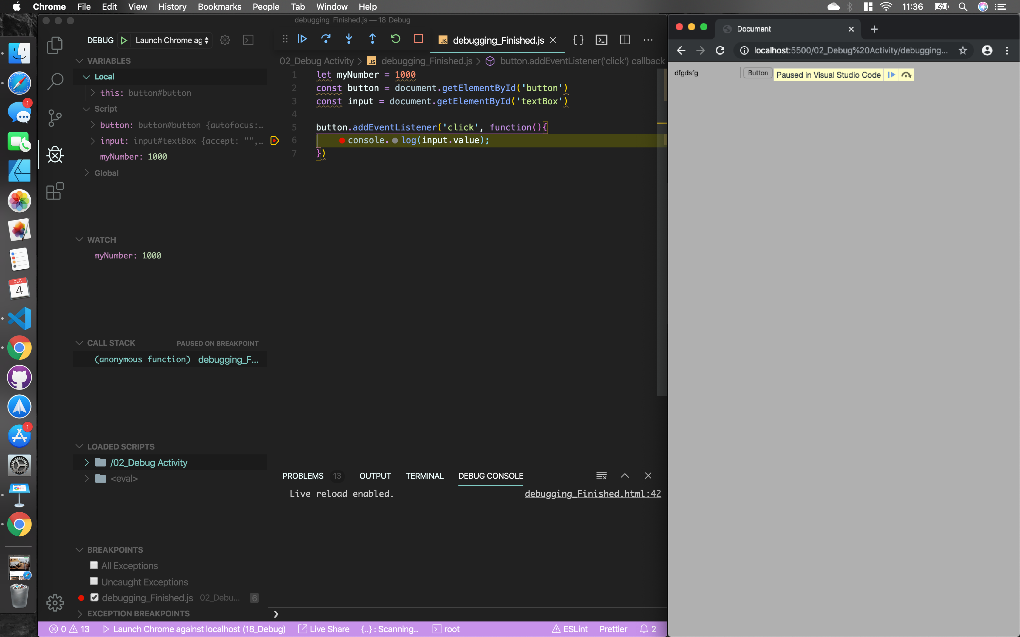
Debugging Tool 2 - VS Code Debugging
When you hit run now a lot of the tools we had is Dev Tools are now in vsCode
This also keeps you in the same IDE and right next to your code

Slide 21
Play
Try using vsCode Debug tools on the VS Code Debugging Files

